Slide 1
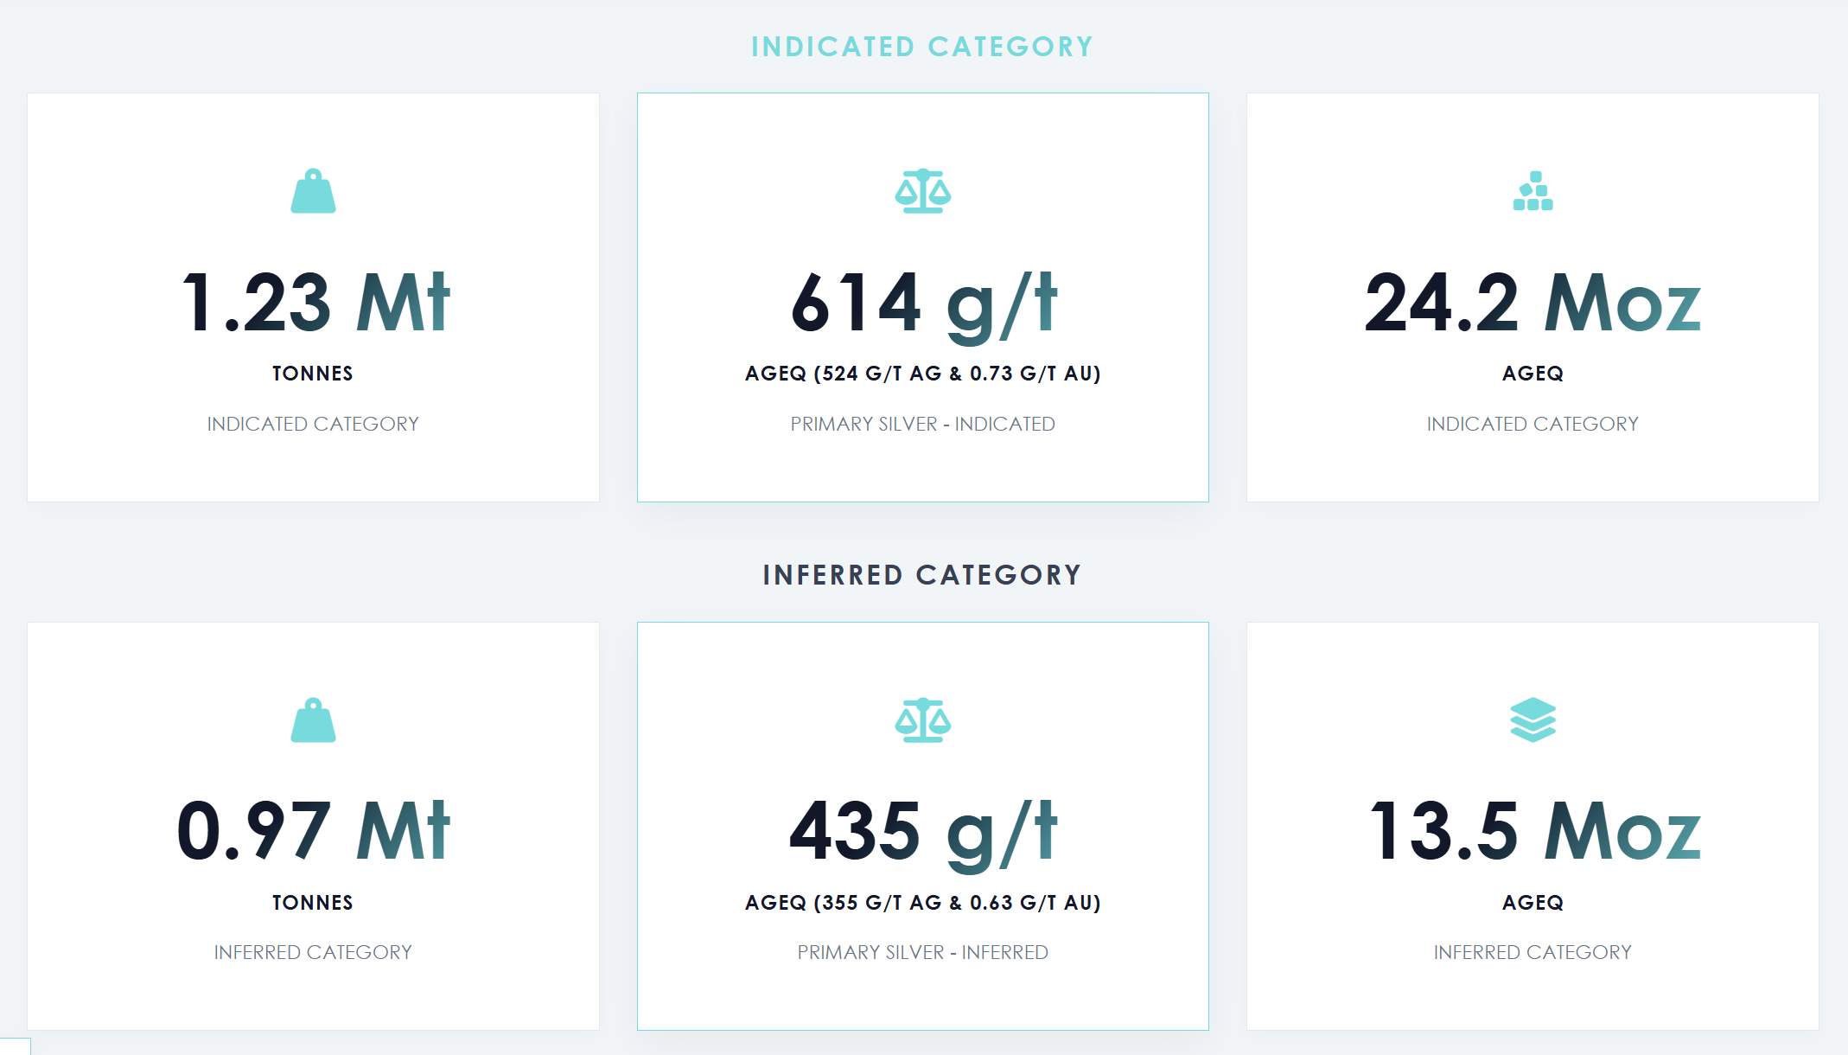
La información sobre el precio de la plata y el precio de las acciones que aparece en la parte superior de la página web es incorrecta.

Slide 2
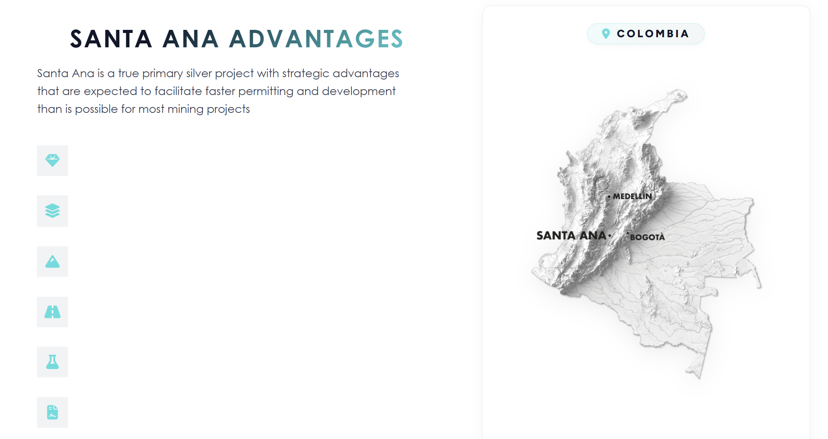
TRUE PRIMARY SILVER PROJECT - with 73% of indicated AgEq resources being from silver, this is a true primary silver project with great scarcity value.
HIGH GRADE RESOURCES - allows a smaller mining operation and plant to produce substantial quantities of silver and gold.
VEINS AT SURFACE - mining can be sequenced so that higher grade zones are targeted early in the mine plan. Newly discovered high-grade veins can be incorporated into mine plans relatively easily.
EXCELLENT INFRASTRUCTURE - road access with power, water, labor, and services available should reduce capital and operating costs, as well as accelerate time to production.
SIMPLE METALLURGY - initial testing suggests high silver and gold recoveries using simple gravity and flotation methods, without the need for cyanide, resulting in a high value precious metals concentrate.
STREAMLINED PERMITTING - the small mining footprint resulting from selective underground mining and a small processing plant, along with strong community and local/regional government support is expected to streamline the permitting process for Santa Ana.
SANTA ANA
x

Slide 3
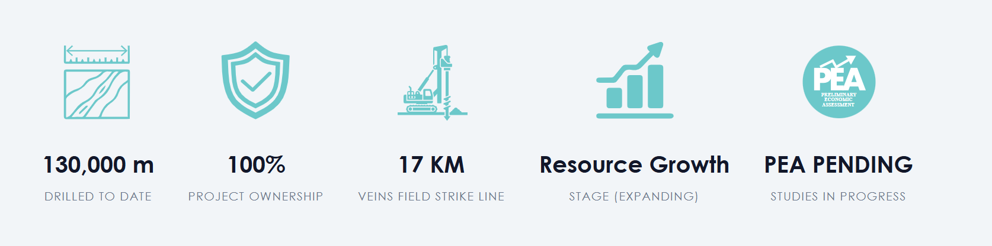

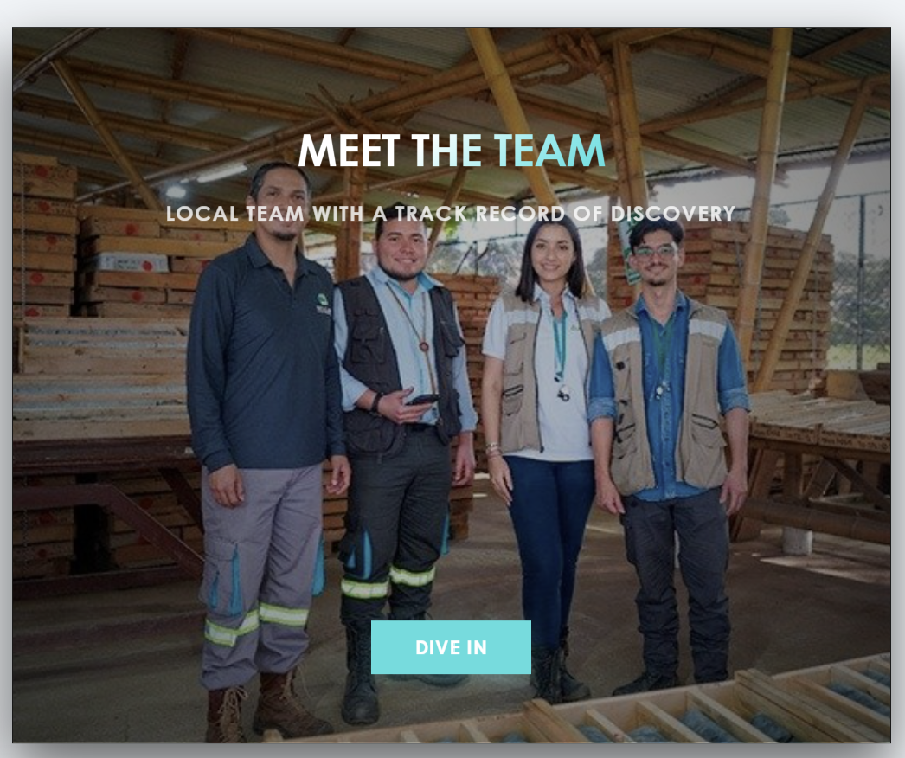
>
https://silverinstitute.org/silver-supply-demand/
STRONG MANAGEMENT TEAM & BOARD

Slide 4

GET THE LATEST INFORMATION

Slide 5
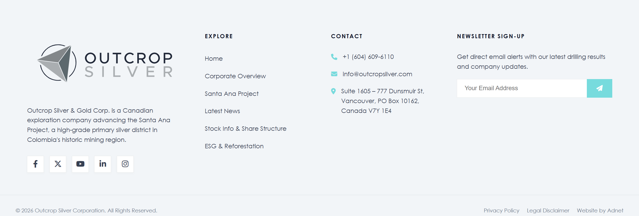
Investors
2026 Outcrop Silver & Gold Corporation. All Rights Reserved.

